Slide 1
Cross-Validation
presentation by Margarita Vartanian
ID 610816

Slide 2
Presentation outline
Introduction
K-Fold Cross-Validation
method description
stratified random sampling
special case of k-fold CV
pros and cons of the method
Possible applications
Example: CV for model tuning
data
grid search
results
Summary

Slide 3
Introduction
Cross-Validation is a resampling method which allows to organise data for model evaluation. It is especially useful when we have a scarce dataset and cannot afford wasting the data.
Cross-validation might be thought of as an extention of train-test split.
Main idea: hold out a random subset, call it test set and keep it. Train the model on the remainder of the data (training set). Use trained model on the test (or validation) set to estimate model performance. Different measures: MSE, accuracy, AUC, precision, recall, etc.
Some types:
Hold-out validation
Complete cross-validation
K-fold cross validation
=> Focus on k-fold cross-validation as one of the most used methods.

Slide 4


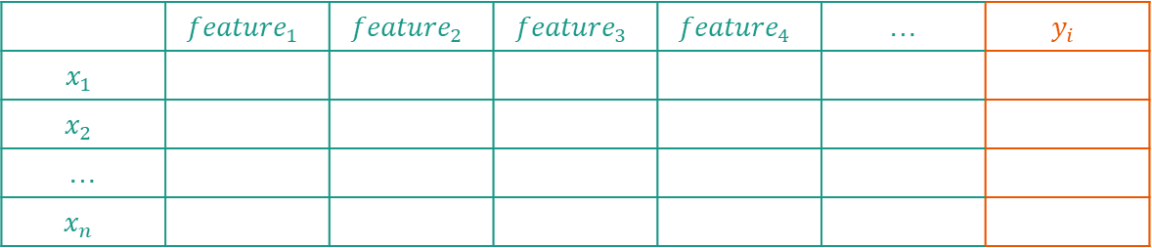
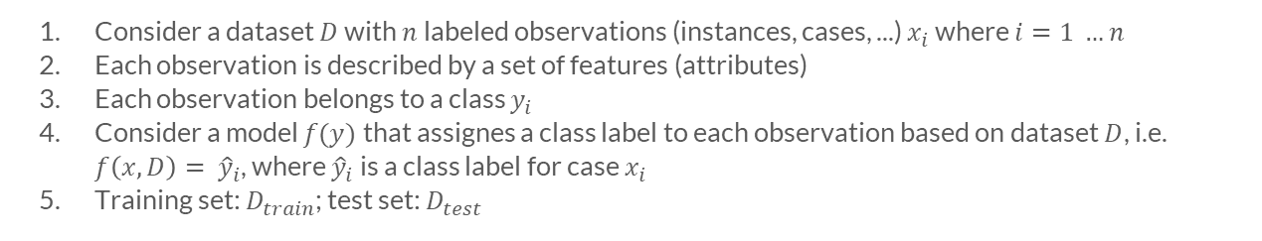
1. Introduction
Consider a dataset $D$ with $n$ labeled observations (instances, cases, ...) $x_{i}$ where $i=1 …n$
Each observation is described by a set of features (attributes)
Each observation belongs to a class $y_{i}$
Consider a model $f(y)$ that assignes a class label to each observation based on dataset $D$, i.e. $f\left(x, D\right)= {\hat{y}}_{i}$, where ${\hat{y}}_{i}$is a class label for case $x_{i}$
Training set: $D_{train}$; test set: $D_{test}$
Features
Label $y_{i}$
Example:
Cases $x_{i}$
 | $${feature}_{1}$$ | $${feature}_{2}$$ | $${feature}_{3}$$ | $${feature}_{4}$$ | … | $$y_{i}$$
$$x_{1}$$
$$x_{2}$$
…
$$x_{n}$$

Slide 5

2. K-Fold Cross-Validation: method description
Divide data is into k folds;
k-1 are training subsets;
Perform k iterations of:
model training on k-1 parts (green);
model testing on the rest (blue).
Each of k parts is used for training just once;
Get k performance measurements for k validation sets, average over them and get cross-validated performance;
In our example, k=5.
MSE 1
MSE 2
MSE 3
MSE 4
MSE 5
Source: https://scikit-learn.org/stable/modules/cross_validation.html

Slide 6
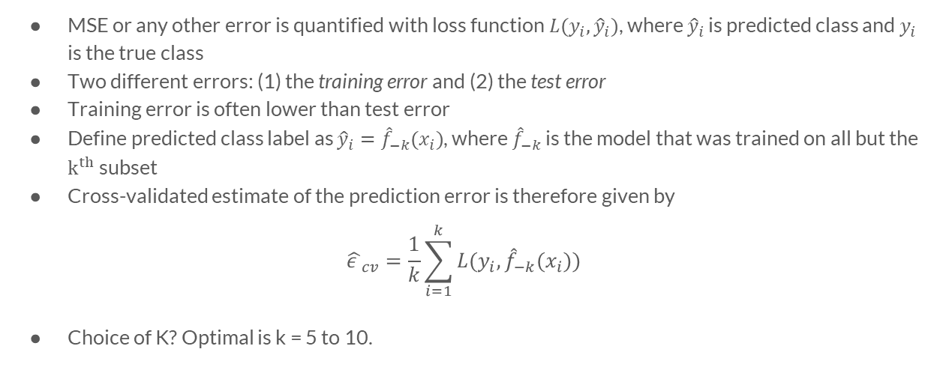
2. K-Fold Cross-Validation: method description
MSE or any other error is quantified with loss function $L(y_{i}, {\hat{y}}_{i})$, where ${\hat{y}}_{i}$ is predicted class and $y_{i}$ is the true class
Two different errors: (1) the training error and (2) the test error
Training error is often lower than test error
Define predicted class label as ${\hat{y}}_{i}={\hat{f}}_{−k}(x_{i})$, where ${\hat{f}}_{−k}$ is the model that was trained on all but the $k^{th}$ subset
Cross-validated estimate of the prediction error is therefore given by
$${\hat{ε }}_{cv}=\frac{1}{k}\sum_{i=1}^{k}{L(y_{i}, {\hat{f}}_{−k}(x_{i}))}$$
Choice of K? Optimal is k = 5 to 10.

Slide 7
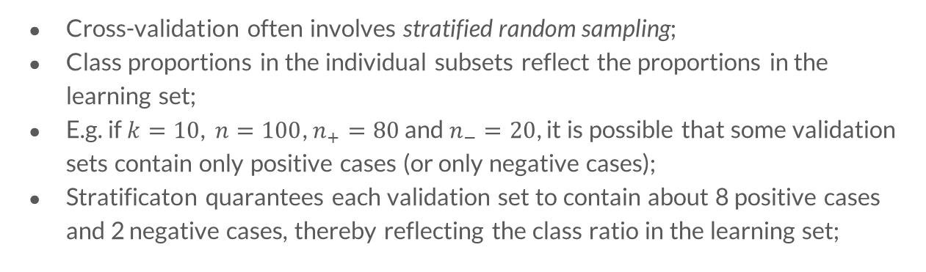
Stratified random sampling
2. K-Fold Cross-Validation
Cross-validation often involves stratified random sampling;
Class proportions in the individual subsets reflect the proportions in the learning set;
E.g. if $k=10$, $n=100$, $n_{+}=80$ and $n_{−}=20$, it is possible that some validation sets contain only positive cases (or only negative cases);
Stratificaton quarantees each validation set to contain about 8 positive cases and 2 negative cases, thereby reflecting the class ratio in the learning set;

Slide 8
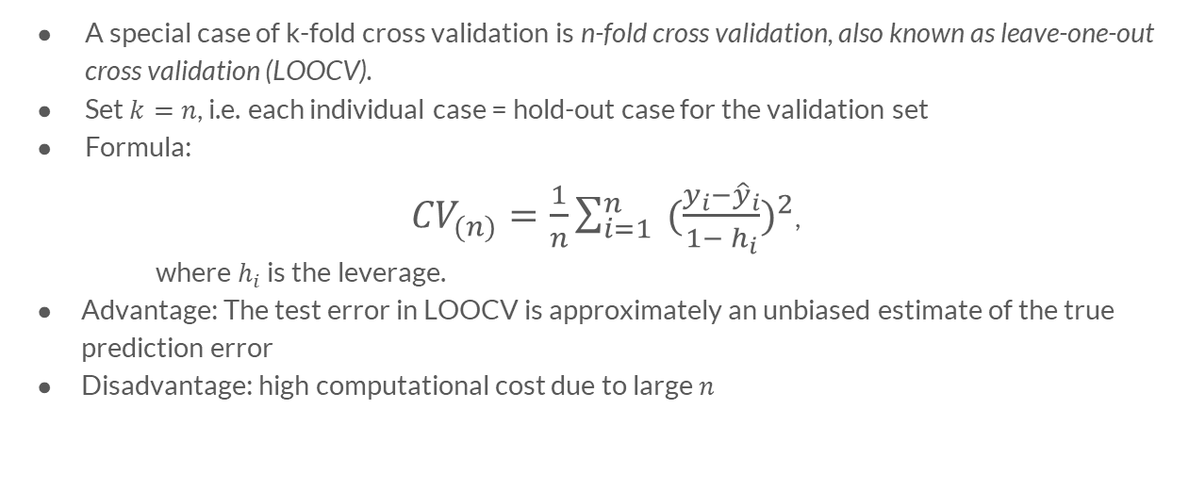
Special case of k-fold CV
2. K-Fold Cross-Validation
A special case of k-fold cross validation is n-fold cross validation, also known as leave-one-out cross validation (LOOCV).
Set $k=n$, i.e. each individual case = hold-out case for the validation set
Formula:
${CV}_{(n)}=\frac{1}{n}\sum_{i=1}^{n}{ {(\frac{y_{i}−{\hat{y}}_{i}}{1− h_{i}})}^{2}}$,
where $h_{i}$ is the leverage.
Advantage: The test error in LOOCV is approximately an unbiased estimate of the true prediction error
Disadvantage: high computational cost due to large $n$

Slide 9
Pros and cons of the method
2. K-Fold Cross-Validation
Provides a reliable measure of how good the model is
Every observation is used for training and testing => no “waste” of data (i.e. no data remains as just test set)
Multiple test errors for different test sets => get an average and std for these test errors => a better idea about the range the actual model accuracy will likely be when you put into production
Might help in preventing overfitting
With many iterations, this method becomes time consuming and requires a large computational effort
Source: https://rapidminer.com/blog/validate-models-cross-validation/

Slide 10
3. Possible applications of CV
CV is primarily used in machine learning.
Performance estimation (e.g. estimate the accuracy of a classifier)
Model selection (e.g. compare a pair of learning algorithms)
Tuning model’s parameters to achieve the best result with a given dataset. Example ->

Slide 11
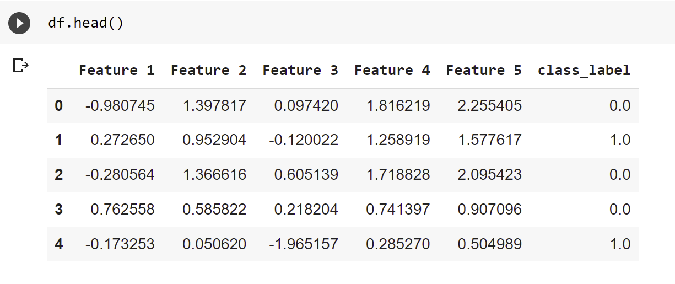
4. Example: CV for tuning model’s parameters
Data: a simulation generated with make_classification() function
500 observations
5 features
Binary label

Slide 12
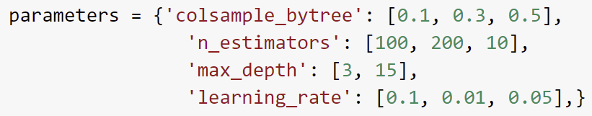
4. Example: CV for tuning model’s parameters
Classification problem: predict class for each observation. For this putpose, I use gradient boosting based model called XGBoost (developer: The XGBoost Contributors).
To build a model, I first need to know its parameters. They can be defined with GridSearchCV by Scikit Learn:
GridSearchCV - an instrument, which is used for automatical search of the best parameters of a ML model. It just iterates over all the possible combinations of parameters and and provides the best ones.
Some possible parameters are:
Grid search defines the best combination of these parameters, see the next slide.

Slide 13
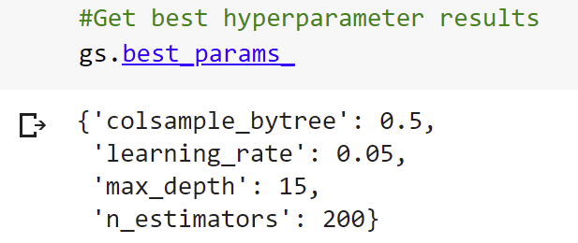
4. Example: CV for tuning model’s parameters
Best parameter values defined by grid search for my model:
Then, I tuned my model with these parameters, ran the model on the test set and obtained these measures of the model’s performance: 0.92 accuracy and 0.98 AUC score.

Slide 14
Summary
CV is one of the most reliable and widely used methods for assessing model’s performance or finding its best parameters (i.e. model tuning);
CV allows to use your data efficiently;
However, CV is costly in terms of computational power.
Example showed use of CV for model tuning.
Plans for further research: use cross validation on real data, try to apply it for model selection.

Slide 15
Reference list
Berrar, Daniel. (2018). Cross-Validation. Tokyo Institute of Technology. DOI 10.1016/B978-0-12-809633-8.20349-X.
Refaeilzadeh P., Tang L., Liu H. (2009) Cross-Validation. In: LIU L., ÖZSU M.T. (eds) Encyclopedia of Database Systems. DOI 10.1007/978-0-387-39940-9_565
https://scikit-learn.org/stable/modules/cross_validation.html
https://rapidminer.com/blog/validate-models-cross-validation/
https://stats.stackexchange.com/questions/18348/differences-between-cross-validation-and-bootstrapping-to-estimate-the-prediction
https://scikit-learn.org/stable/modules/generated/sklearn.model_selection.GridSearchCV.html
https://vc.ru/ml/147132-kak-avtomaticheski-podobrat-parametry-dlya-modeli-mashinnogo-obucheniya-ispolzuem-gridsearchcv

